Slide 1

Working with Transformations

Slide 2

Introduction to Transformation
Change in form of appearance, nature etc
A complete or Major Change
Alteration
In Photoshop, Transform is used to scale, rotate, skew, and just distort the perspective of any graphic you’re working with in general.

Slide 3
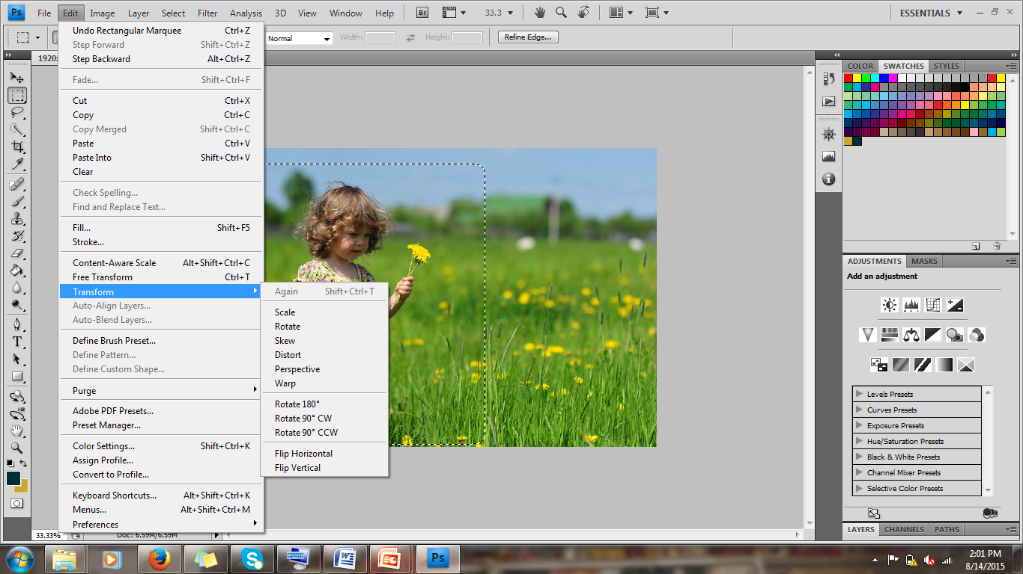
Path to choose Transformations

Slide 4

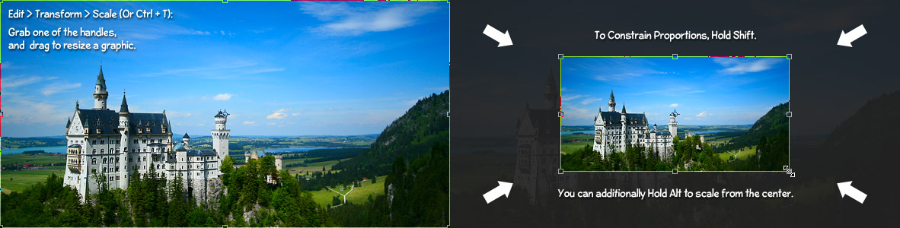
Scaling
Scaling allows you to enlarge or shrink a graphic around a reference point

Slide 5
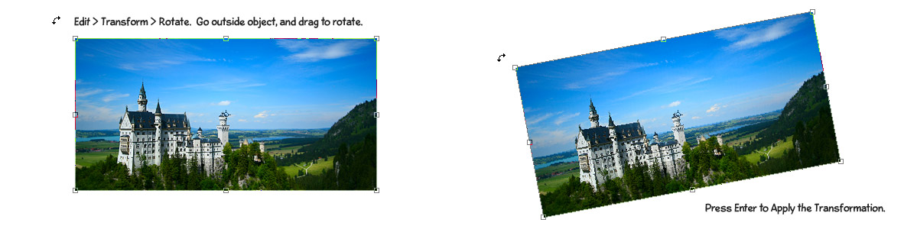
Rotating
Rotate a particular selected area. By default, this point is at the center of the object

Slide 6
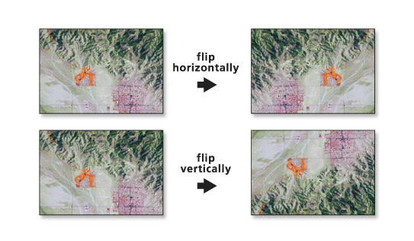
Flip
Flip the items vertically or horizontally

Slide 7
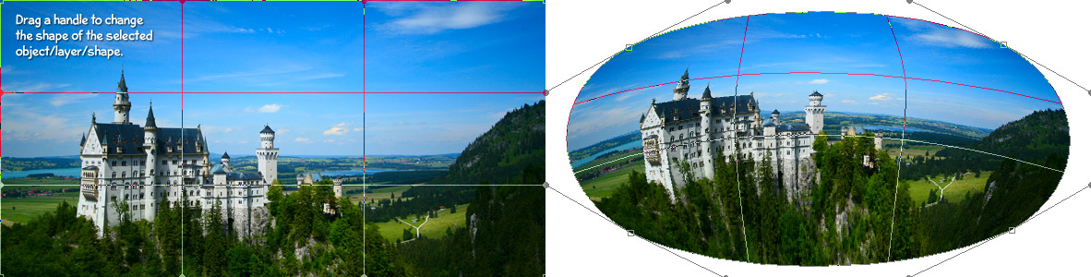
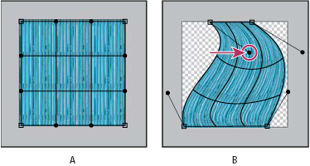
Warp
Warp manipulates the shape of an item

Slide 8
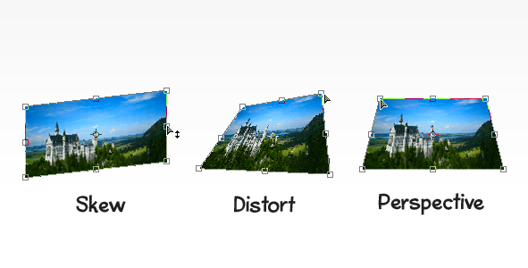
Skew, Distort and Perspective
Slant objects either vertically or horizontally
Stretching on the image on any of selected angle
Applies one point perspective to an item.

Slide 9
Transformation Techniques
      Scale – Scaling allows you to enlarge or shrink a graphic around a reference point.(Resize a selected area)
      Rotate – Rotate a particular selected area. By default, this point is at the center of the object; however, you can move it to another location.
      Flip – Flip the items vertically or horizontally.
      Warp – Warp manipulates the shape of an item.
      Skew – Skew transformations slant objects either vertically or horizontally(Twist the images in specific direction).
      Distort – Distort transformations allow you to stretch an image in ANY direction freely(Stretching on the image on any of selected angle).
      Perspective – The Perspective transformation allows you to add perspective to an object(Change the distance of particular part).

Slide 10


